Slide 1
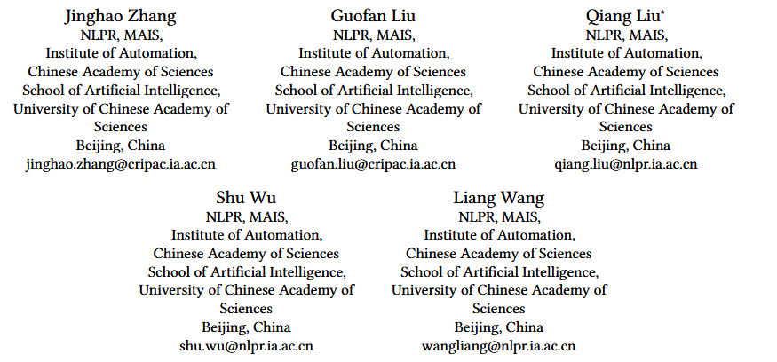



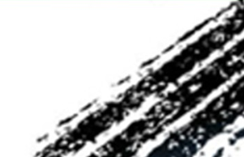

Modality-Balanced Learning for Multimedia Recommendation
（MM-2024)
Reported by Jingbo Liu

Slide 2
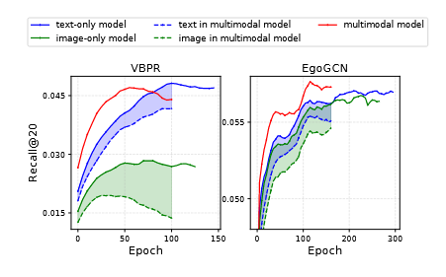
Motivation
the integration of multiple modalities often encounters the modal imbalance problem: since the information in different modalities is unbalanced, optimizing the same objective across all modalities leads to the under-optimization problem of the weak modalities with a slower convergence rate or lower performance. Even worse, we find that in multimodal recommendation models, all modalities suffer from the problem of insufficient optimization. To address these issues, we propose a Counterfactual Knowledge Distillation (CKD) method which could solve the imbalance problem and make the best use of all modalities.

Slide 3
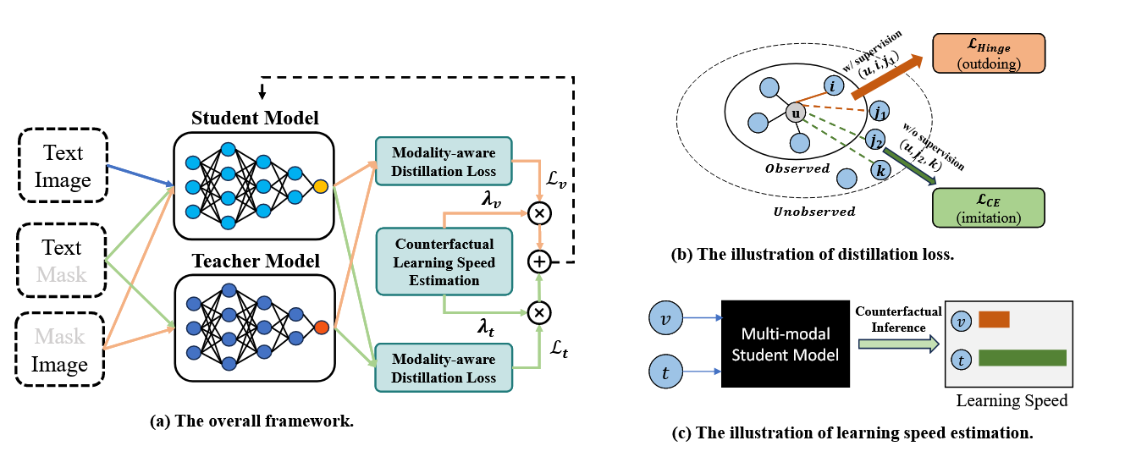
Method

Slide 4
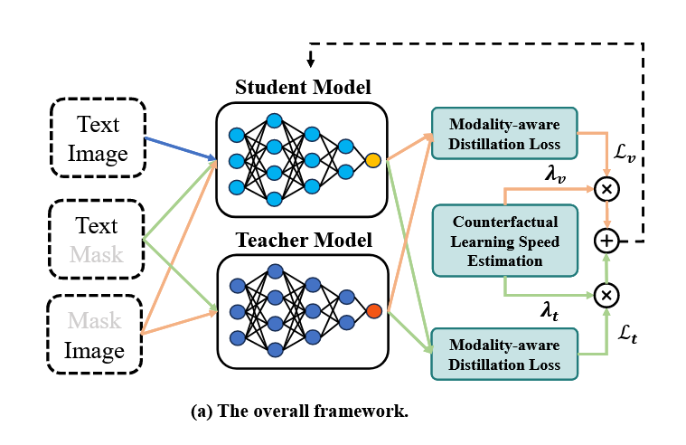
Method
Image+Mask
Image+Text
Teacher
model
Student model
Student
model
求差
修正
速度权重λv

Slide 5
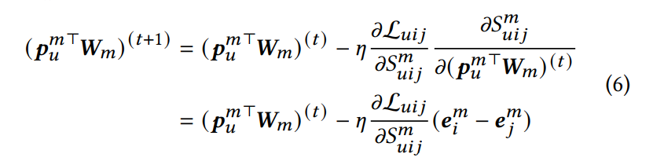

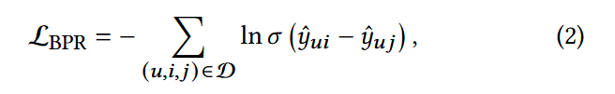
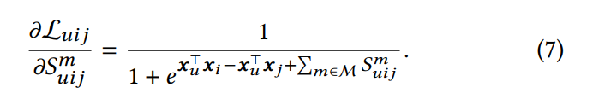

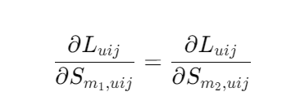
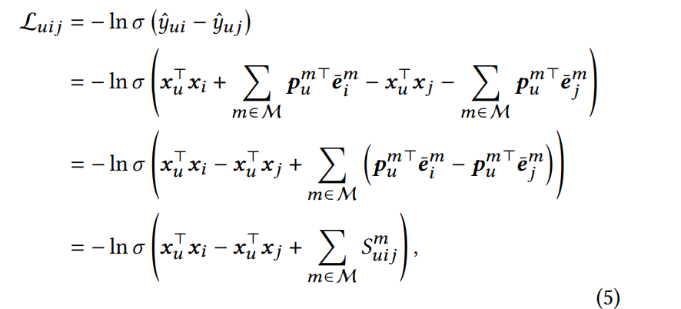


Slide 6
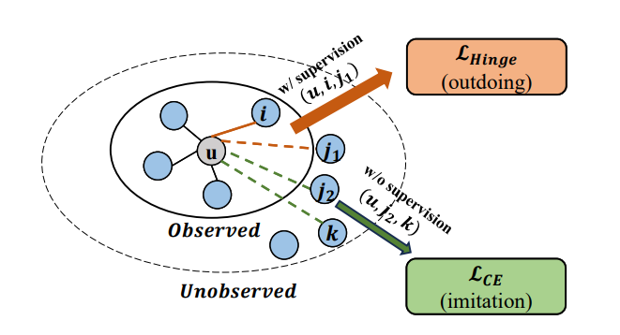



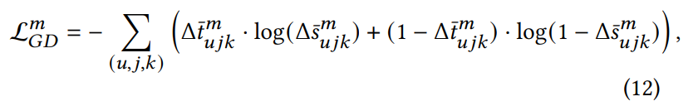

Slide 7
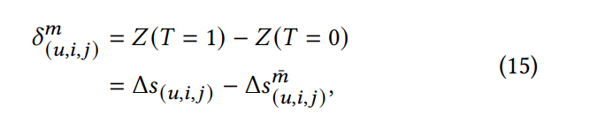
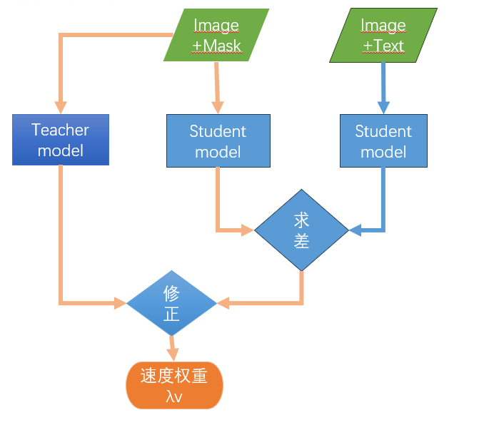
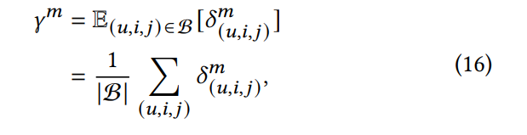
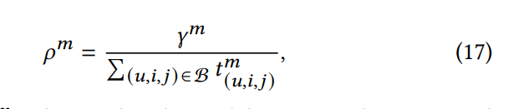

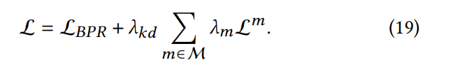

Slide 8
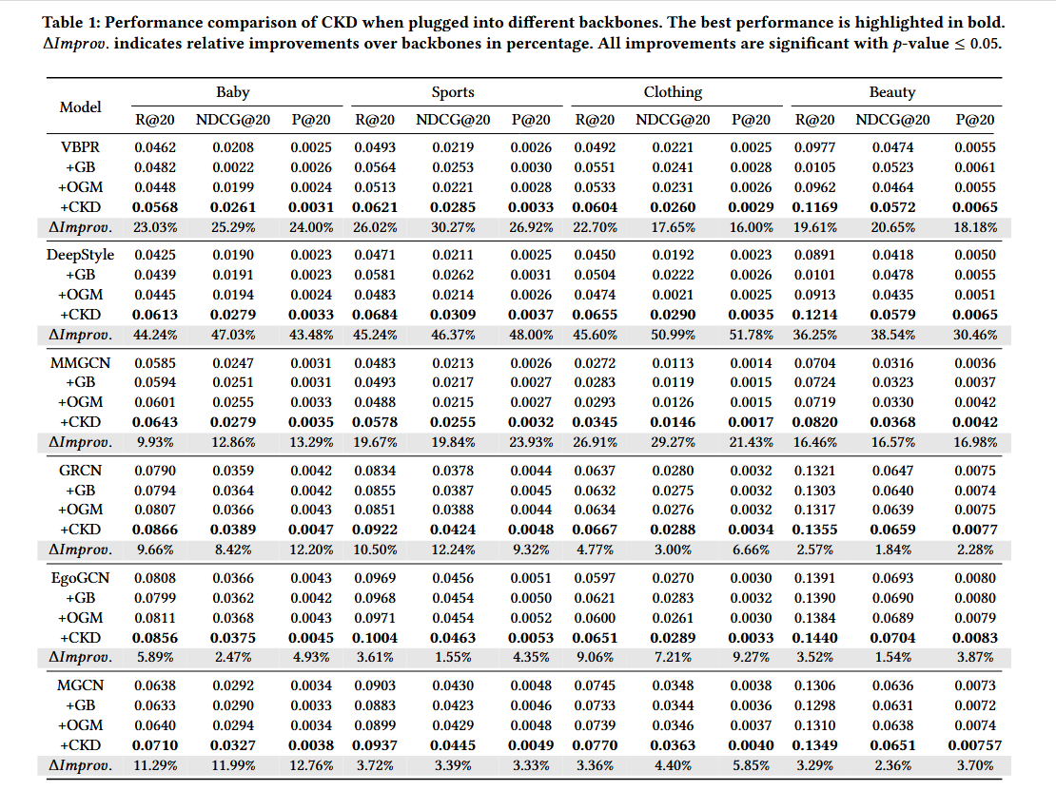
Experiment

Slide 9
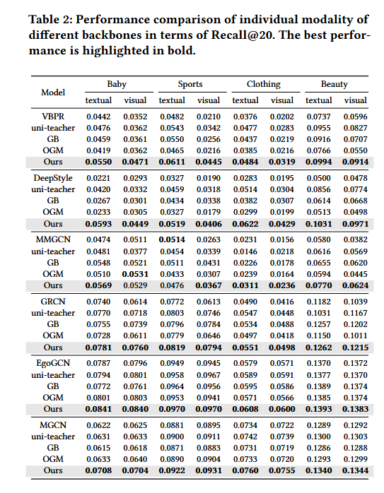
Experiment

Slide 10
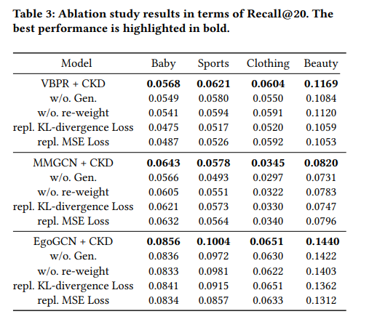
Experiment

Slide 11
Thank you!

